Slide 1



ENGINE TALK
PERFORMANCE • PRESTIGE • POWER
Krishna | Chaitanya Bansal
AUTOMOTIVE WEB PLATFORM

Slide 2
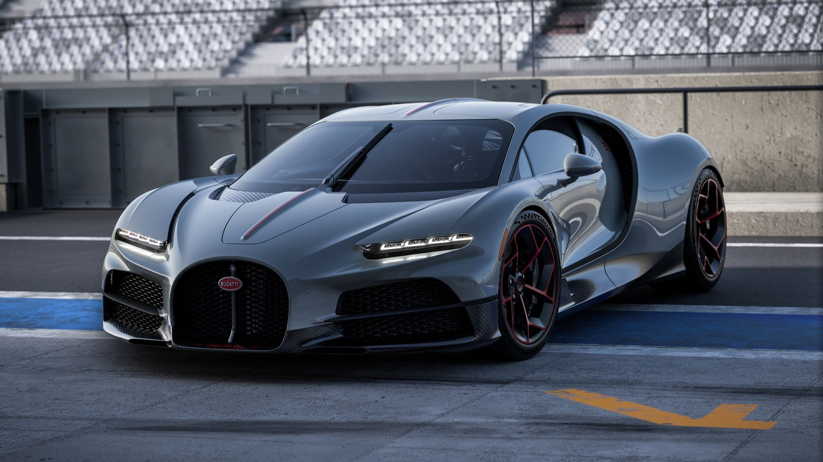

01 / PROBLEM STATEMENT
Luxury car enthusiasts lacked a single, premium destination to browse brands, performance specs, and high-res visuals in one immersive interface.
Most existing sites lacked real-time interactivity. Users couldn't visualize car colors live or manage persistent carts without backend accounts.

Slide 3





02 / PROJECT OBJECTIVES
PREMIUM SHOWCASE
DYNAMIC FILTERING
INTERACTIVE GARAGE
Clean, high-performance website for exotic luxury vehicles.
Instant sorting by brand, horsepower, or type via JS.
Real-time color configurator and live spec explorer.

Slide 4
03 / USER JOURNEY
LOGIN
Secure entry
SHOWROOM
Browse Cars
GARAGE
Customize Cars
Configure
SELECTION
Full catalog
CHECKOUT
Finalize

Slide 5
04 / CHALLENGES & RESOLUTIONS
Challenge | Resolution Strategy | Outcome
State Persistence | Implementation of a unified local Storage architecture using the 'cart' key. | Achieved seamless session continuity and persistent user carts without backend overhead.
UI Fluidity | Engineered asynchronous CSS transitions and JS-driven DOM manipulation. | Delivered a "Zero-Reload" experience with sub-300ms visual state transitions.
Visual Performance | Optimization of heavy CSS filters and neon effects via media-query targeting. | Maintained 60FPS performance and high visual fidelity across varying hardware.

Slide 6

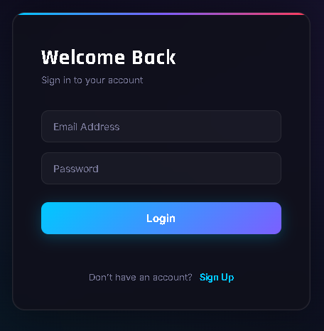
P1 / LOGIN & REGISTRATION
SECURE ACCESS MODE
Allows users to create a new account and log in securely
Stores user credentials using browser Local Storage
Performs real-time input validation for better accuracy
Maintains user session even after page refresh Modern dark-themed interface with smooth animations
Automatically redirects authenticated users to the homepage

Slide 7
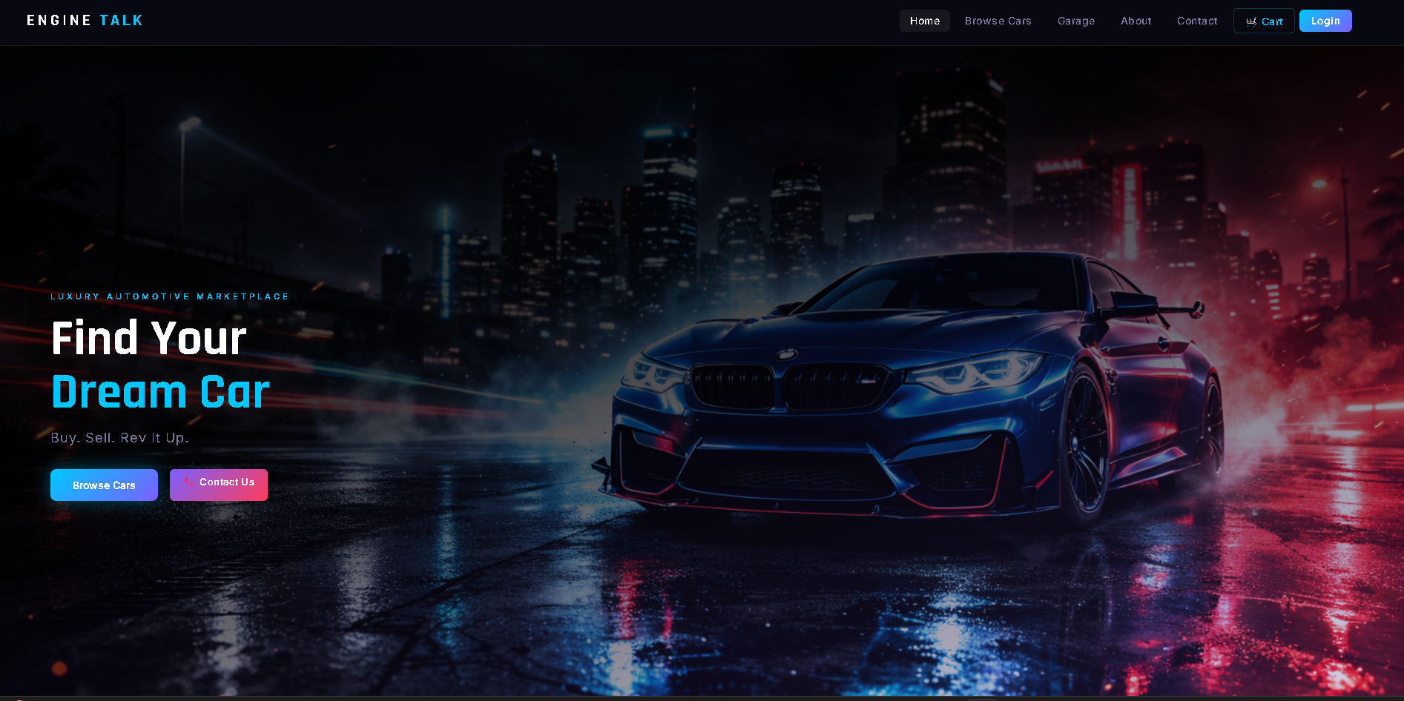
P2 / SHOWROOM EXPERIENCE
THE HOMEPAGE
◈
Full-screen hero section with animated tagline entrance
◈
Featured Cars grid with curated top performance models
◈
Sticky navigation with cart count badge

Slide 8
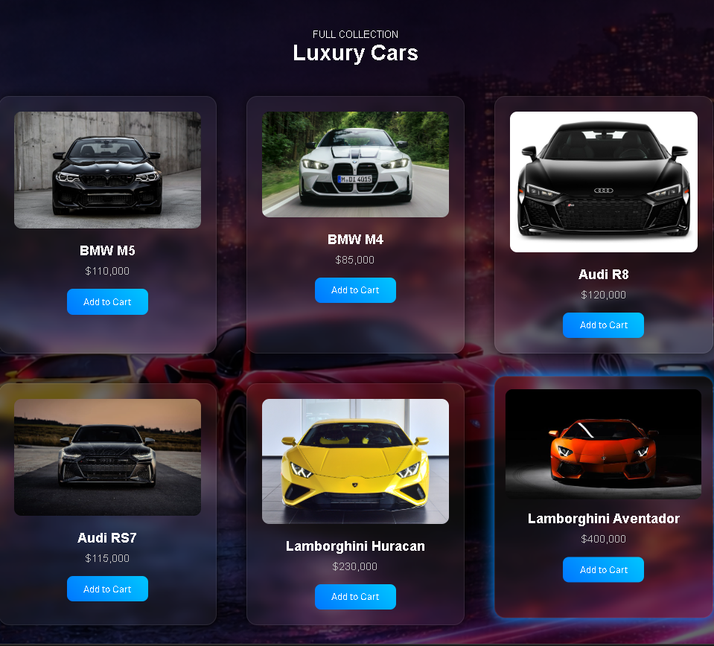
P3 / DISCOVERY ENGINE
INTELLIGENT CATALOG
A high-fidelity grid featuring 12 exotic models with real-time DOM filtering.
◈
Multi-criteria filtering: Brand, Type, HP
◈
No-reload instant UI re-renders
◈
Responsive grid (3-col to 1-col mobile)
◈
Detailed car cards with live pricing

Slide 9
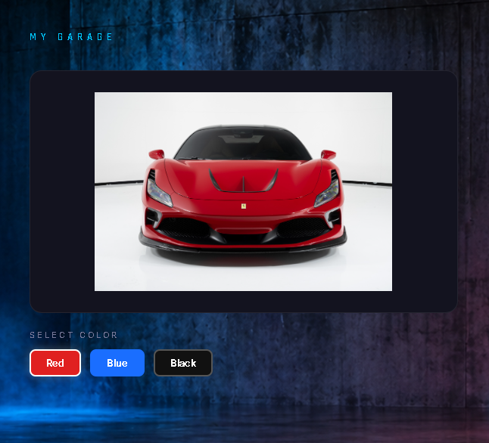
P4 / INTERACTIVE GARAGE
REAL-TIME PERSONALIZATION
◈
Flagship brands: Porsche, Ferrari, McLaren
◈
3 custom paint colors with live previews
◈
Async fade transitions for smooth swapping
◈
Dynamic spec panel updates on-the-fly
◈
Direct "Add to Garage" cart integration

Slide 10
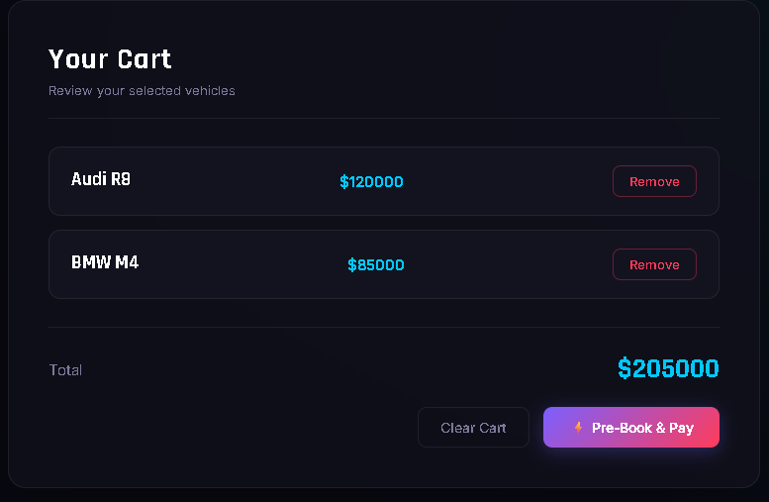
P5 / CART MANAGEMENT
MY GARAGE SELECTION
A transparent staging area where users review their tailored builds before checking out.
◈
Persistent Summary: Syncs configured car details, selected paint finishes, and custom specs.
◈
Live Total Matrix: Instant multi-item price addition calculations directly inside the DOM.
◈
Frictionless Pruning: Dynamic item removals with low-latency smooth layout transitions.

Slide 11
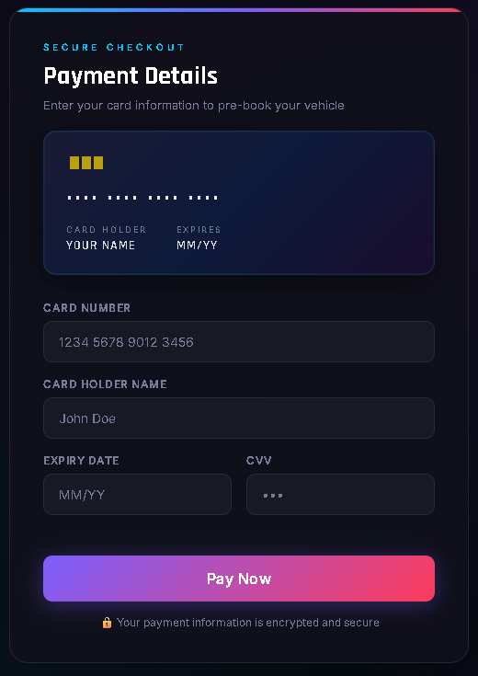

P6 / PREMIUM PAYMENT UI
Frictionless Transactions
A secure checkout flow designed for high-trust premium automotive acquisitions.
◈
Cart validated globally via 'et_cart' state string
◈
Interactive layout matching premium payment styles
◈
Neon error alerts on blank or malformed input
◈
Automated success gateway landing mechanics

Slide 12
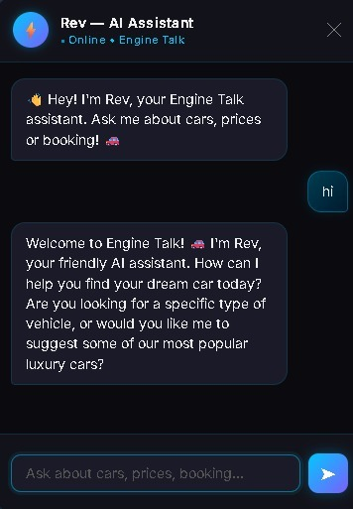
P7 / AI CONCIERGE
Intelligent API Integration
Engine Talk now features a sophisticated AI Chatbot powered by state-of-the-art Large Language Models to assist users throughout their journey.
◈
24/7 Expert Support: Instant answers to technical specifications and model availability.
◈
Personalized Discovery: Suggests exotic vehicles based on unique performance profiles.
◈
Seamless Handover: Direct connection to specialist support for bespoke acquisitions.

Slide 13

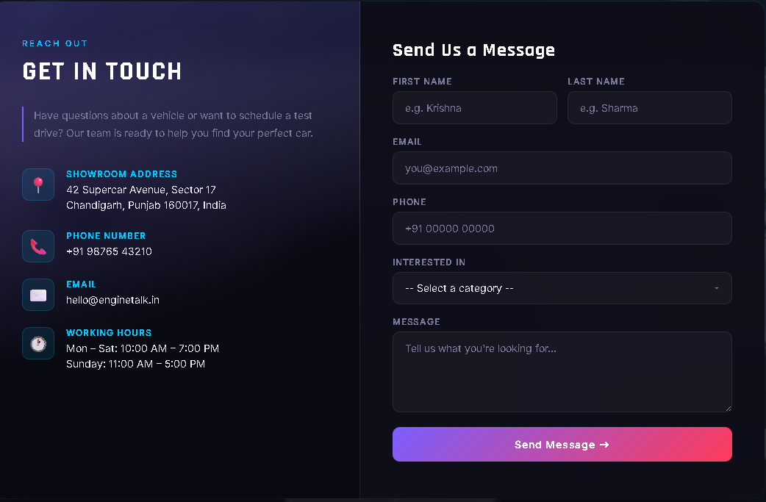
P8 / CONTACT US
ELITE SUPPORT
Connect with the Engine Talk specialists for bespoke acquisitions and technical inquiries. Our team is available 24/7 for members.
hello@enginetalk.in
+91 98765 43210
42 Supercar Avenue, Sector 17
Chandigarh, Punjab 160017, India

Slide 14


THANK YOU
KRISHNA
CHAITANYA BANSAL
ROLL NUMBER: 2510992866
ROLL NUMBER: 2510992870
BE CSE with AI & ML | Semester II
BE CSE with AI & ML | Semester II

